Slide 1
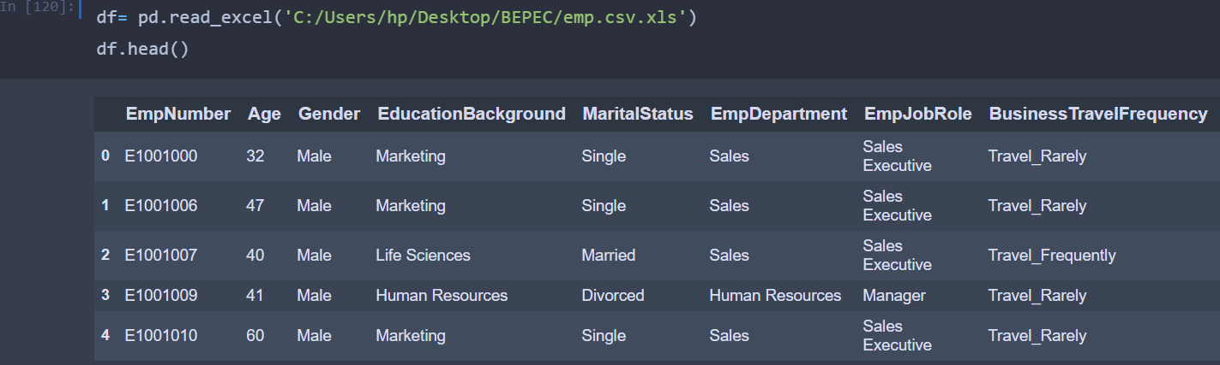
EMPLOYEE PERFORMANCE ANALYSIS
Problem statement:Recent years, the employee performance indexes are not healthy and this is becoming a growing concerns among the top management. There has been increased escalations on service delivery and client satisfaction levels came down by 8 percentage points.
Dataset provided:
Dataset provided has information of 1200 employees of the company,28 columns which shows different features of particular employee in excel format.

Slide 2
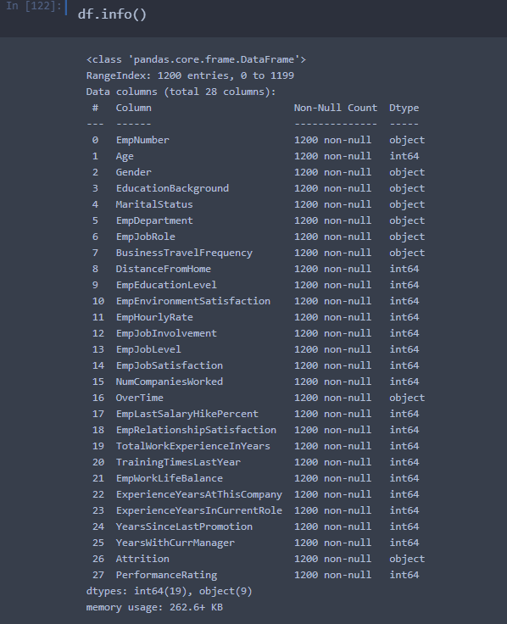
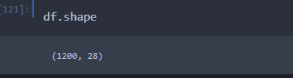
Columns in the dataset:
Shape of dataset:
Total no.of rows=1200
Total no.of columns=27

Slide 3
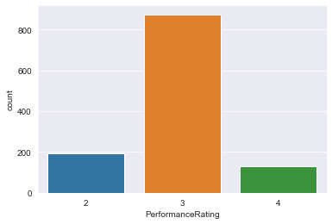
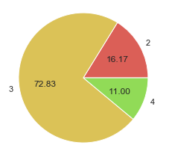
Target variable : Performance Rating
Counts:
3 -874
2 -194
4 -132
Total:1200
Most of the employees have
Performance rating as 3(72.83%)

Slide 4
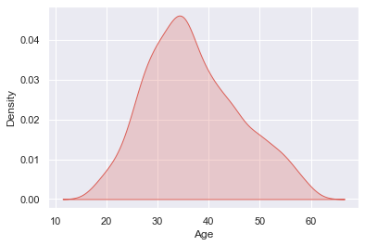
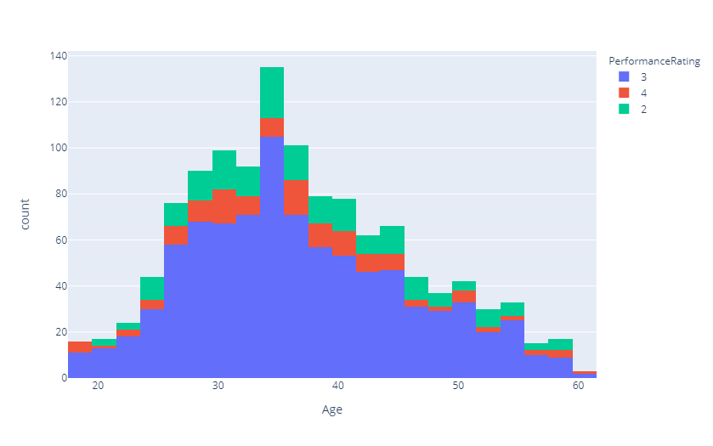
count 1200.000000 mean 36.918333
Std 9.087289
min 18.000000
25% 30.000000
50% 36.000000
75% 43.000000
max 60.000000
*Most of the employees
are in the age 30-42.
*Average age of the
employees at the company is 36.
*Where minimum age is
18 and maximum 60.
*positive skewness is
Observed in the given dataset for age.

Slide 5
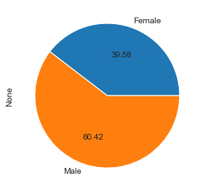
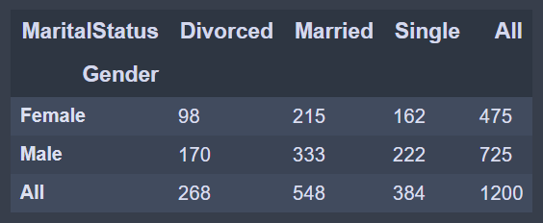
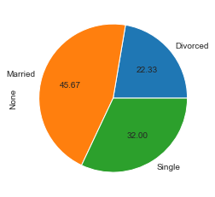
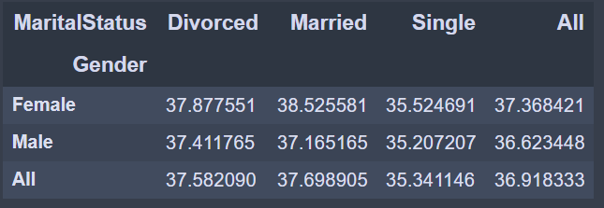
Gender and marital status:
Average ages of employees based
on gender and marital status:

Slide 6
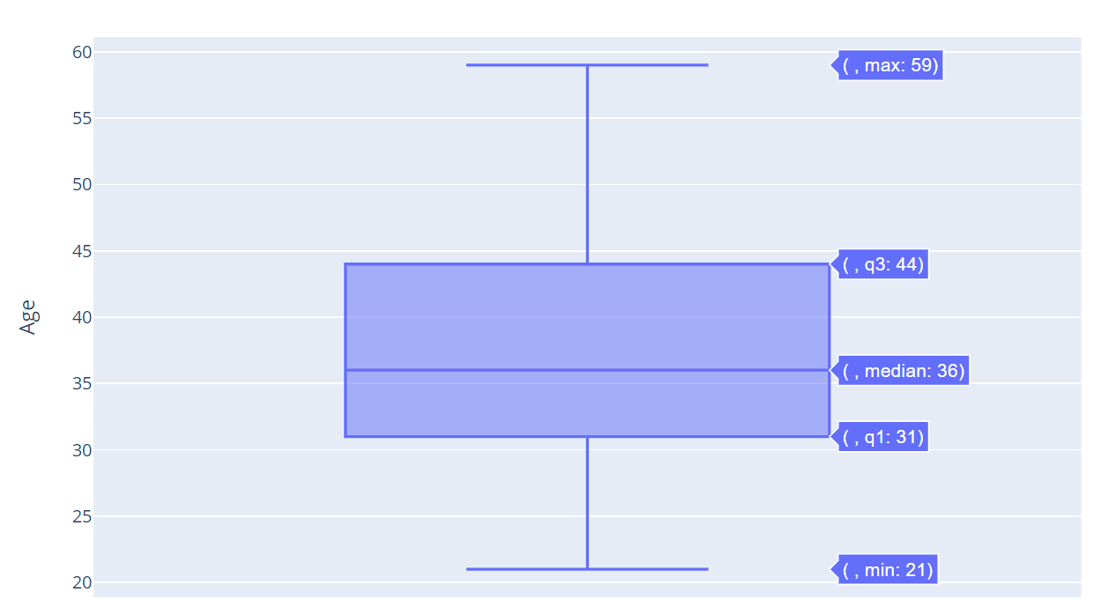
Distribution of age of employees
whose performance rating is 2:
Performance rating is less for employees whose age is between (31-44)

Slide 7
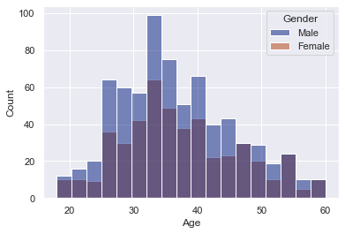
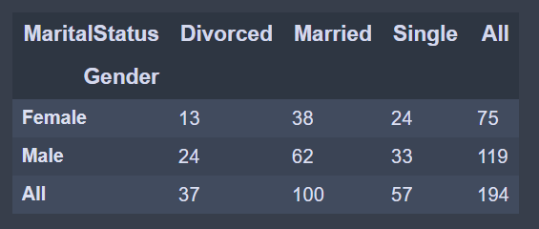
*There are total 194 employees whose performance rating is low(=2),where
119 are Male and 75 are female
39 people in between 20-29
52 people between 30-35
61 people between 36-45
34 people between 46-55
8 people between 56-59

Slide 8
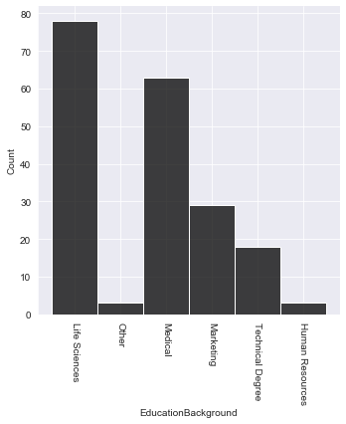
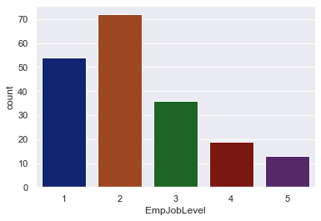
Count of low performing employees
based on educationbackground :
Count of low performing employees
based on Joblevel:
Employees of job levels 1 and 2
Are not performing well
Life sciences and medical education background are not performing well

Slide 9
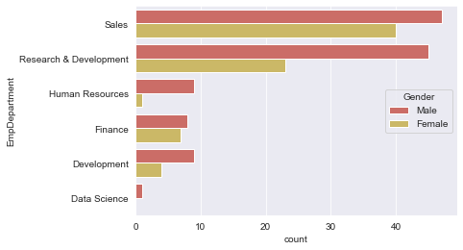
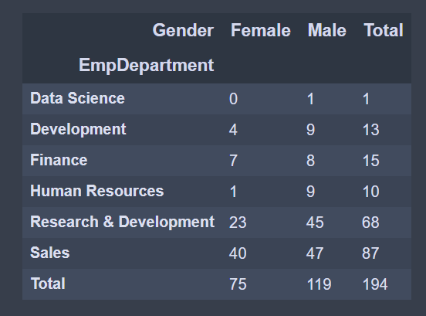
Department wise count of employees not working properly:
=>Sales ,research&Devolopment departments
are not working properly
Among them males are not working properly.

Slide 10
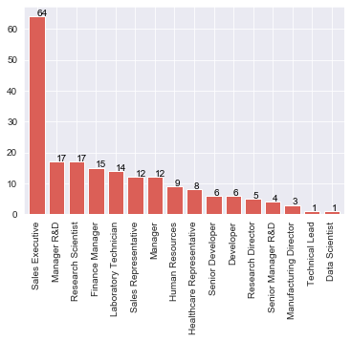
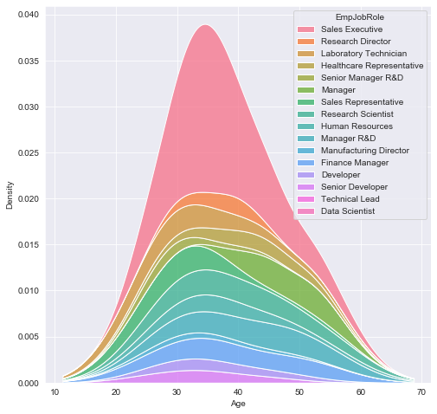
Job role wise count of employees not working properly:
Sale executive job role has many Employees who are not working properly
with count as high as 64
Manager R&D ,Reasearchscientist,Finance manager, Laboratory technician,Sales representative and manager are the job roles having low performance employees

Slide 11
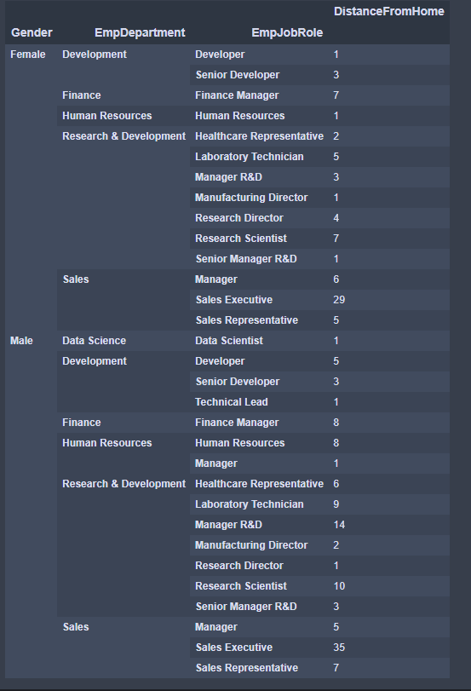

Slide 12
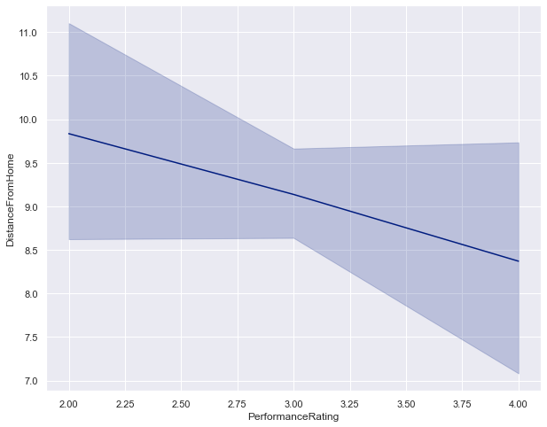
Performance rating vs distance from home:
For performance rating=2, the distance is high and is low for
performance ratings 3 and 4

Slide 13
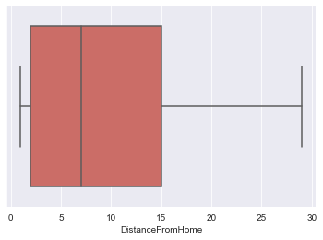
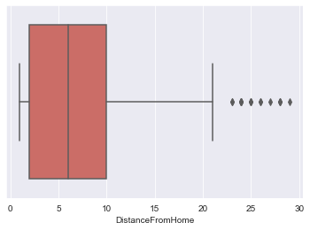
PerformanceRating=2:
count 194.000000
mean 9.835052
std 8.737010
min 1.000000
25% 2.000000
50% 7.000000
75% 15.000000
max 29.000000
from box plot ,we can observe that 75% of employee's distance from home whose pf=4 falls under 10 whereas for pf=2 it is under 15
PerformanceRating=4:
count 132.000000
mean 8.371212
std 8.033713
Min 1.000000
25% 2.000000
50% 6.000000
75% 10.000000
max 29.000000

Slide 14
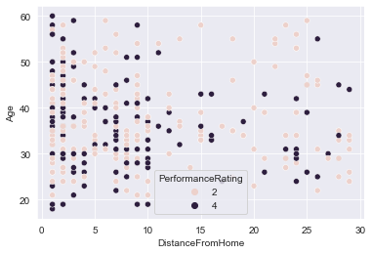
These
employees can be provided work from home
in order to increase performance
From scatter plot we can observe many points of pf=2(pink) and
less of pf=4 (purple) after distance 15.
The region covered rectangle indicates distance more than 15.

Slide 15
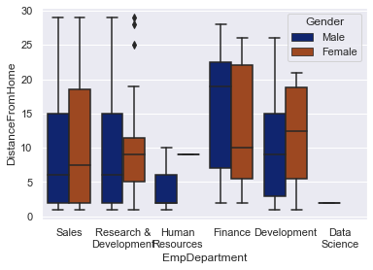
Sales employees
R&D male employees
Finance employees
Development male employees
are the departments
having more distance from home

Slide 16
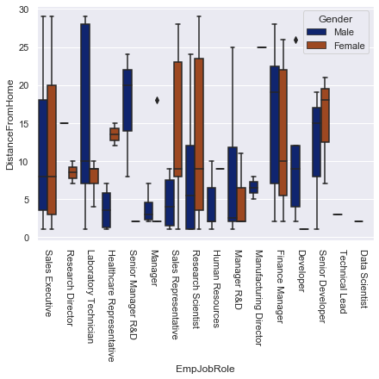
Sales executives
Male research director
Male healthcare representative
Female sales representatives
Female research scientist
Male manager r&d
Finance managers
Are the employees having
More distance from home
And they can be allowed for
Work from home if possible
Or can also provide cab facility
If not already provided

Slide 17
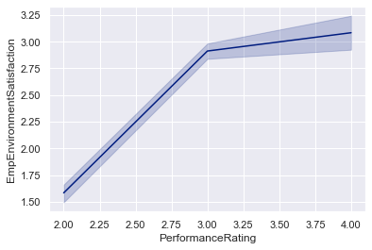
Employee environment satisfaction:
Up trend shows that , employee environment
satisfaction is directly proportional to
performance rating.

Slide 18
Performance rating=2:
Performance rating=4:
Employee environment satisfaction | Count
2 | 98
1 | 90
4 | 3
3 | 3
Employee environment satisfaction | Count
3 | 54
4 | 51
1 | 14
2 | 13
Count tables clearly shows that , low performance=2 has more employees with
low satisfaction(1,2)
Whereas high performance employees=4, has more employees with high
satisfactions(3,4)
Therefore trying to improve employee’s environment might bring up good
results in performance

Slide 19
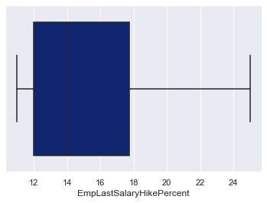
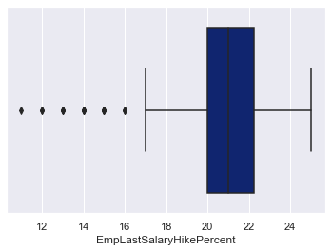
Employee last salary hike percentage:
Performance rating=2 :
Performance rating=4:
from above we can notice that employees who has performance rating 4 have min
LastSalaryHikePercent of 17% ignoring outliers whereas for employees whose performance rating is 2 has minimum LastSalaryHikePercent 11% with this observation we can improve Salary hike percentage of employees whose
performance is low to at least 17%(minimum of pf=4) from boxplot excluding few outliers

Slide 20
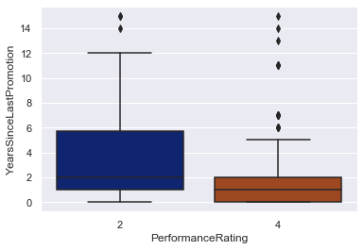
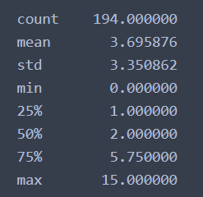
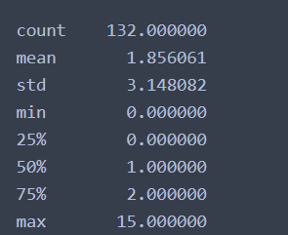
Years since last promotion:
From boxplot we can observe
that ,for pf=2 no.of years since
last promotion are between(1-5)
,whereas for high performance
rating=4 ignoring few outliers
no.of years since last promotion
is low(1-2)
=>Therefore providing frequent promotions will help in performance growth.

Slide 21
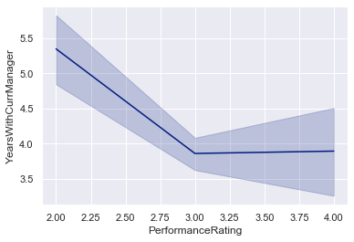
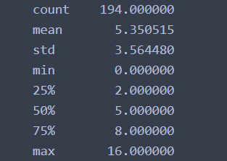
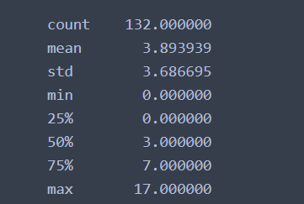
Years with current manager:
Performance rating=2 :
Performance rating=4 :
YearsWithCurrManager does effect employees
performance as the plot show for performance
rating 2 the no.of years with current manager
is high and for good performance rating 3 and
4 no.of years with current manager is low
Change manager after certain period of time
around 3 or 4 years would help

Slide 22
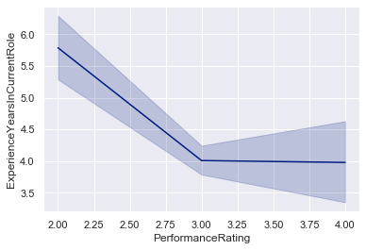
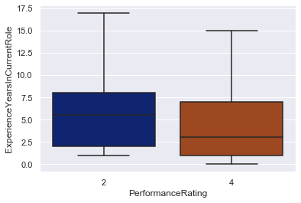
Experience years in current role:
average Experience years of a employee in current low for high performing
employee is 3,whereas for low performance employee is 5
May be by working in the same role for many years may cause lose of interest
for the employees , which should be looked after by the company.

Slide 23
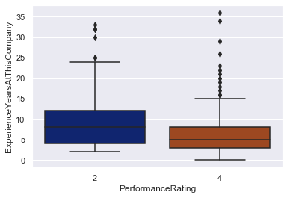
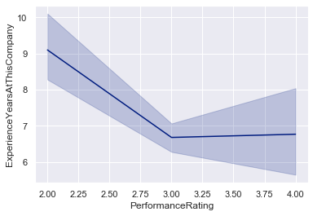
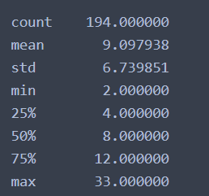
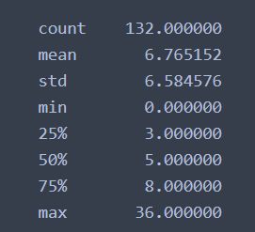
Experience Years at this company
More the experience at company
lesser the performance of employee
,this is the considerable issue company
should look after.

Slide 24
THANK YOU!

